Slide 1


Welcome to Building OWL in Protégé
PIZZA.OWL
Xiaoqi Zhao
Protégé Learning Repository: https://github.com/yasenstar/protege_pizza
Protégé Pizza Tutorial: https://www.michaeldebellis.com/post/new-protege-pizza-tutorial

Slide 2


Initialize Protege
Why Protégé
Protégé at a glance
Choose proper version
Installation and initialization

Slide 3
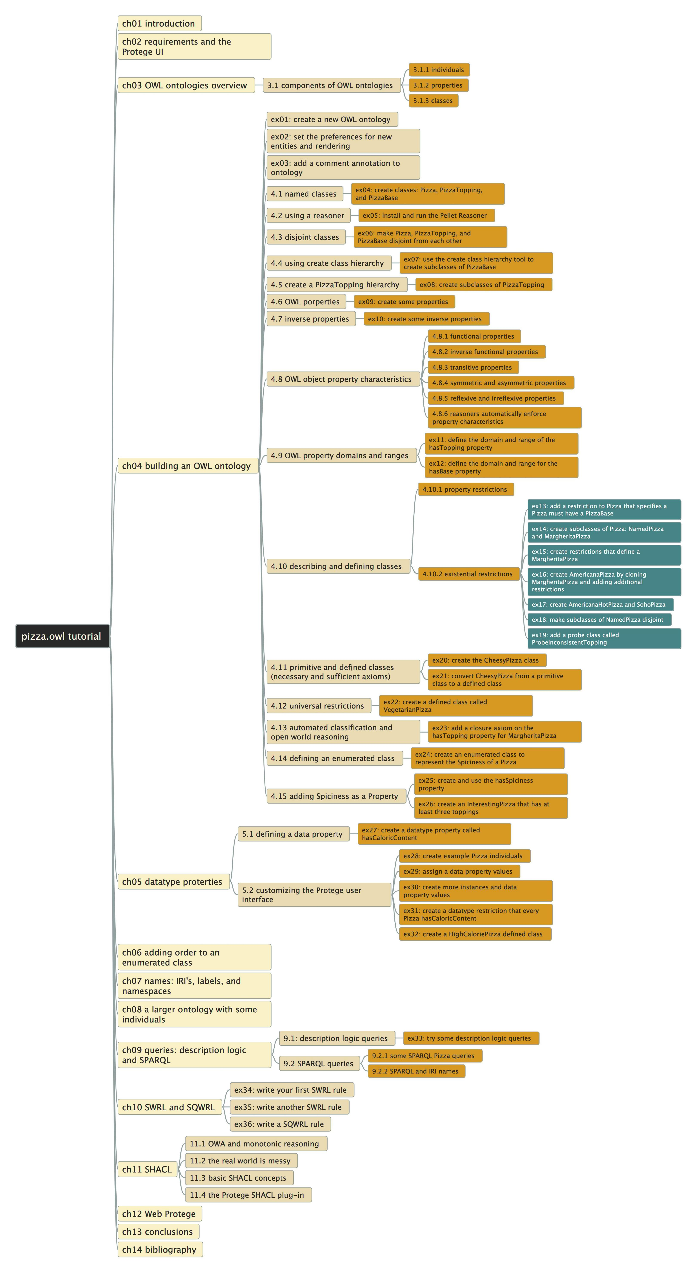
Pizza.owl Tutorial
Author: Michael DeBellis
Latest version 3.2
Learn step by step
14 chapters
36 exercises

Slide 4

Structure of Video List
Similar like my previous “ArchiSurance” and “ArchiMetal” videos
Protégé is the tool, we focus on learning ontology structure (from pizza.owl) and modeling skills (actual using Protégé)
Every video covers 1 or 1+ exercises
Github repository tracks the snapshot model file, mapping to every video
When applicable, will discuss and abstract certain modeling pattern
Goal: know protégé, know ontology from hands-on practice

Slide 5
Building OWL in Protégé
PIZZA.OWL
02 – Structure on pizza.owl case study
Xiaoqi Zhao
Protégé Learning Repository: https://github.com/yasenstar/protege_pizza
Protégé Pizza Tutorial: https://www.michaeldebellis.com/post/new-protege-pizza-tutorial

Slide 6
Building OWL in Protégé
PIZZA.OWL
03 – Initial Protégé Environment
Xiaoqi Zhao
Protégé Learning Repository: https://github.com/yasenstar/protege_pizza
Protégé Pizza Tutorial: https://www.michaeldebellis.com/post/new-protege-pizza-tutorial

Slide 7
Building OWL in Protégé
PIZZA.OWL
04 – Create New Owl Ontology (ex01,02,03)
Xiaoqi Zhao
Protégé Learning Repository: https://github.com/yasenstar/protege_pizza
Protégé Pizza Tutorial: https://www.michaeldebellis.com/post/new-protege-pizza-tutorial

Slide 8
Building OWL in Protégé
PIZZA.OWL
05 – Named Classes
(ex04)
Xiaoqi Zhao
Protégé Learning Repository: https://github.com/yasenstar/protege_pizza
Protégé Pizza Tutorial: https://www.michaeldebellis.com/post/new-protege-pizza-tutorial

Slide 9
Building OWL in Protégé
PIZZA.OWL
06 – Using a Reasoner
(ex05)
Xiaoqi Zhao
Protégé Learning Repository: https://github.com/yasenstar/protege_pizza
Protégé Pizza Tutorial: https://www.michaeldebellis.com/post/new-protege-pizza-tutorial

